Slide 1
Physics Tutorial 5
Functioning Like a Physicist

Slide 2



Introduction
Self-Study Recap
Exponential Graphs
Radioactive Decay
Questions

Slide 3
Introduction

Slide 4
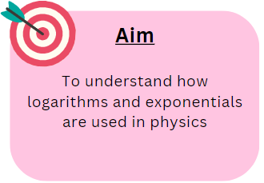
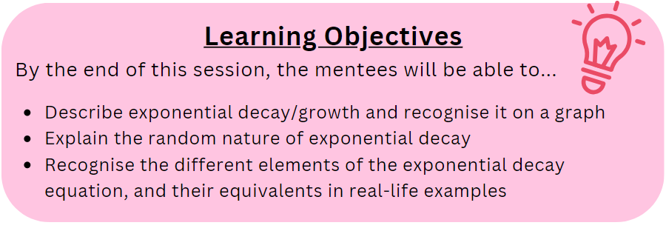
Aims and Learning Objectives

Slide 5
Ground Rules Reminder
You will need to attempt the home learning before the tutorial for the course to be effective.
Try to find a quiet space where you will not be interrupted, and spend at least 30 minutes on these problems. They could take up to an hour.
We do not expect you to always be able to answer every question in the home-learning, or during the tutorial. Being a good physicist is not about being able to answer everything straight away! We do want you to think about why you are getting stuck, and which questions you need to ask to help you develop your physics skills.
We would like you to attempt every question and record all your working and assumptions, even if you do not get a final answer.
Please arrive on time to the tutorials (aim to be a couple of minutes early if possible) and have the following materials with you:
  answers electronically or written down
  pen and paper
  a scientific calculator
Notes:
If needed

Slide 6
Self-Study Recap

Slide 7
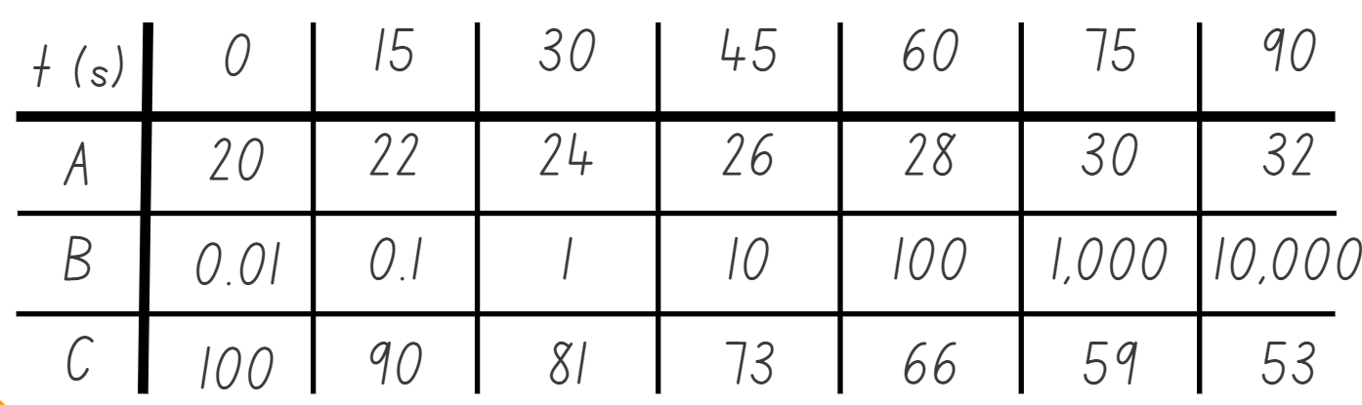
Task 1: Find the Odd One Out
Which one is not decaying exponentially?
It’s A!

Slide 8
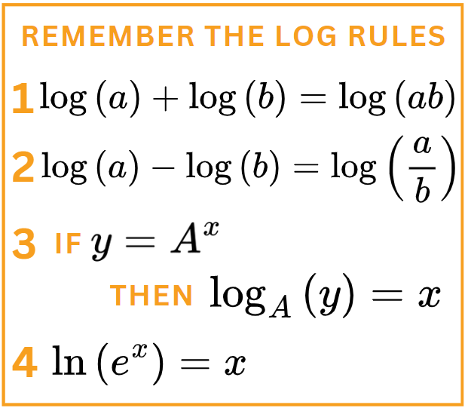


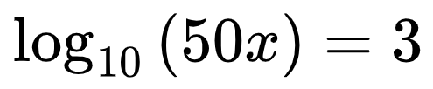

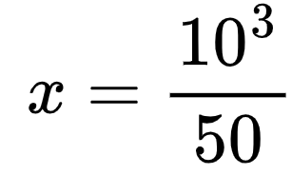
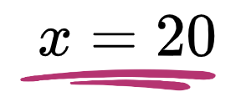
Task 2: Log Problems
Using Rule 1:
We can re-arrange using Rule 3:
Then some algebra to get:

Slide 9




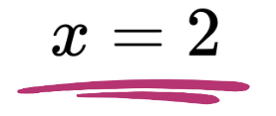
Task 2: Log Problems
Using Rule 3:
We know how to re-arrange powers:
Then calculate to get:

Slide 10



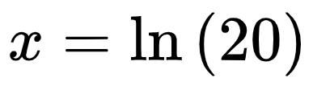
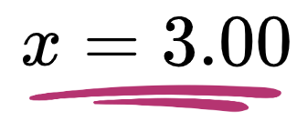
Task 2: Log Problems
Using the reverse of Rule 3:
We know that log to base e is:
Then calculate to get:
to 3 sig. fig.

Slide 11

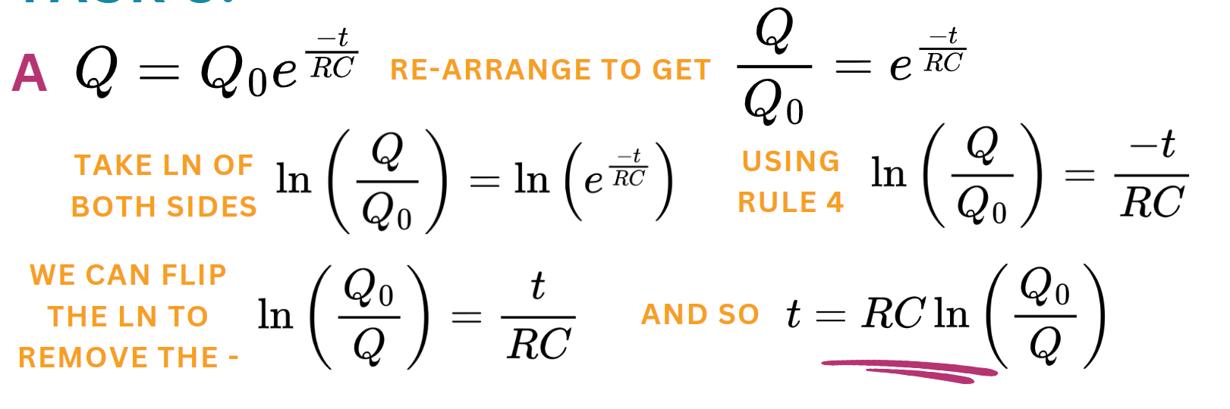
Task 3: Real Problems
Notes:
If mentees are confused about removing the minus sign, remind them they can use Rule 2 to split the ln up into ln(Q) – ln(Q0). Removing the minus sign then makes it ln(Q0) – ln(Q), and it can be put back into the formula above using Rule 4 again. It’s why the Q0 is now on the top!

Slide 12

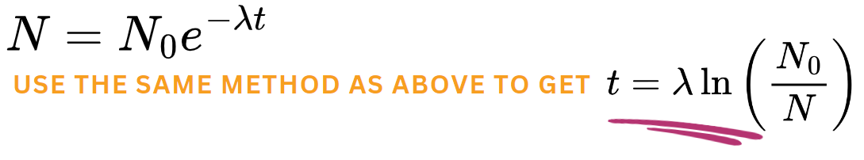
Task 3: Real Problems
Notes:
If mentees are confused about removing the minus sign, remind them they can use Rule 2 to split the ln up into ln(Q) – ln(Q0). Removing the minus sign then makes it ln(Q0) – ln(Q), and it can be put back into the formula above using Rule 4 again. It’s why the Q0 is now on the top!

Slide 13
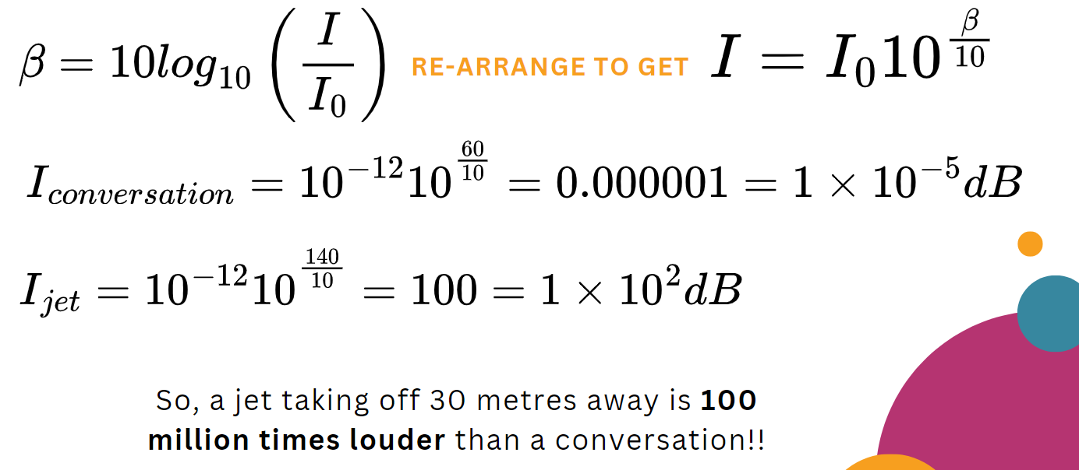
Optional Extras

Slide 14

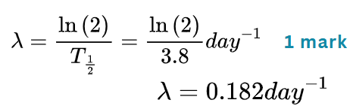
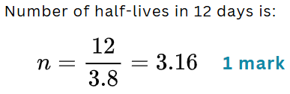
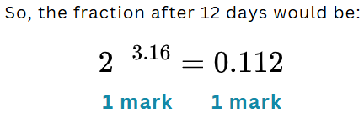
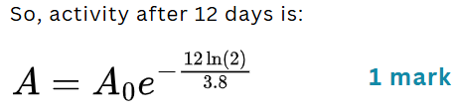

Exam Practice

Slide 15

Exam Practice
Counts per minute is reduced significantly / almost by half (or equivalent) by the paper, so alpha radiation is present
Most of the remaining radiation is stopped / counts per minute reduces again by the aluminium, so beta radiation is present
The count for lead is similar to aluminium, so no gamma radiation is present
The measured counts with aluminium and lead are basically the same, so the background radiation is ~25 counts per minute
The increased value for lead is because of the randomness of nuclear decay

Slide 16
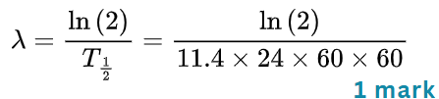
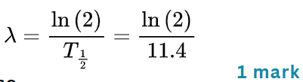


Exam Practice

Slide 17
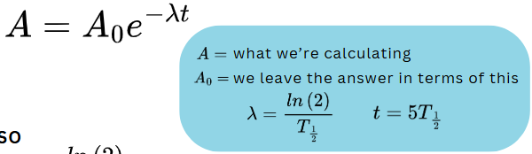
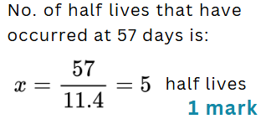



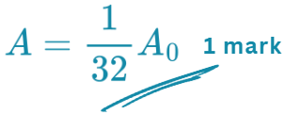
Exam Practice

Slide 18




Exam Practice

Slide 19
Exponential Graphs

Slide 20
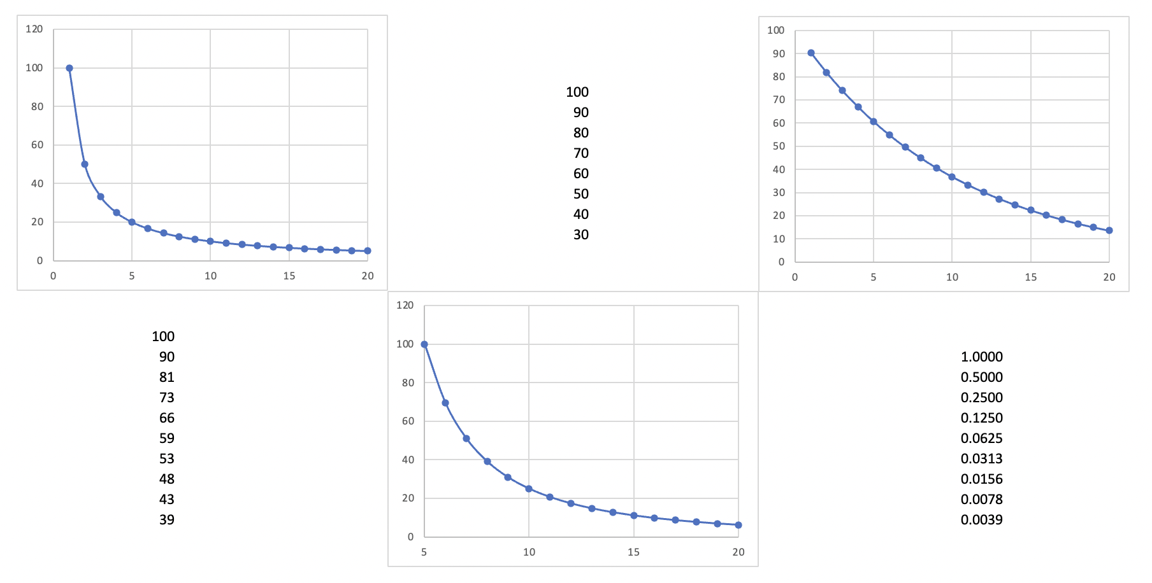
Which graphs show exponential decay?
D
A
B
C
E
F

Slide 21


Which graphs show exponential decay?
D
A
B
C
E
F
Notes:
The top-left graph is a 1/x graph.
The bottom-middle graph is a 1/x^2 graph.

Slide 22
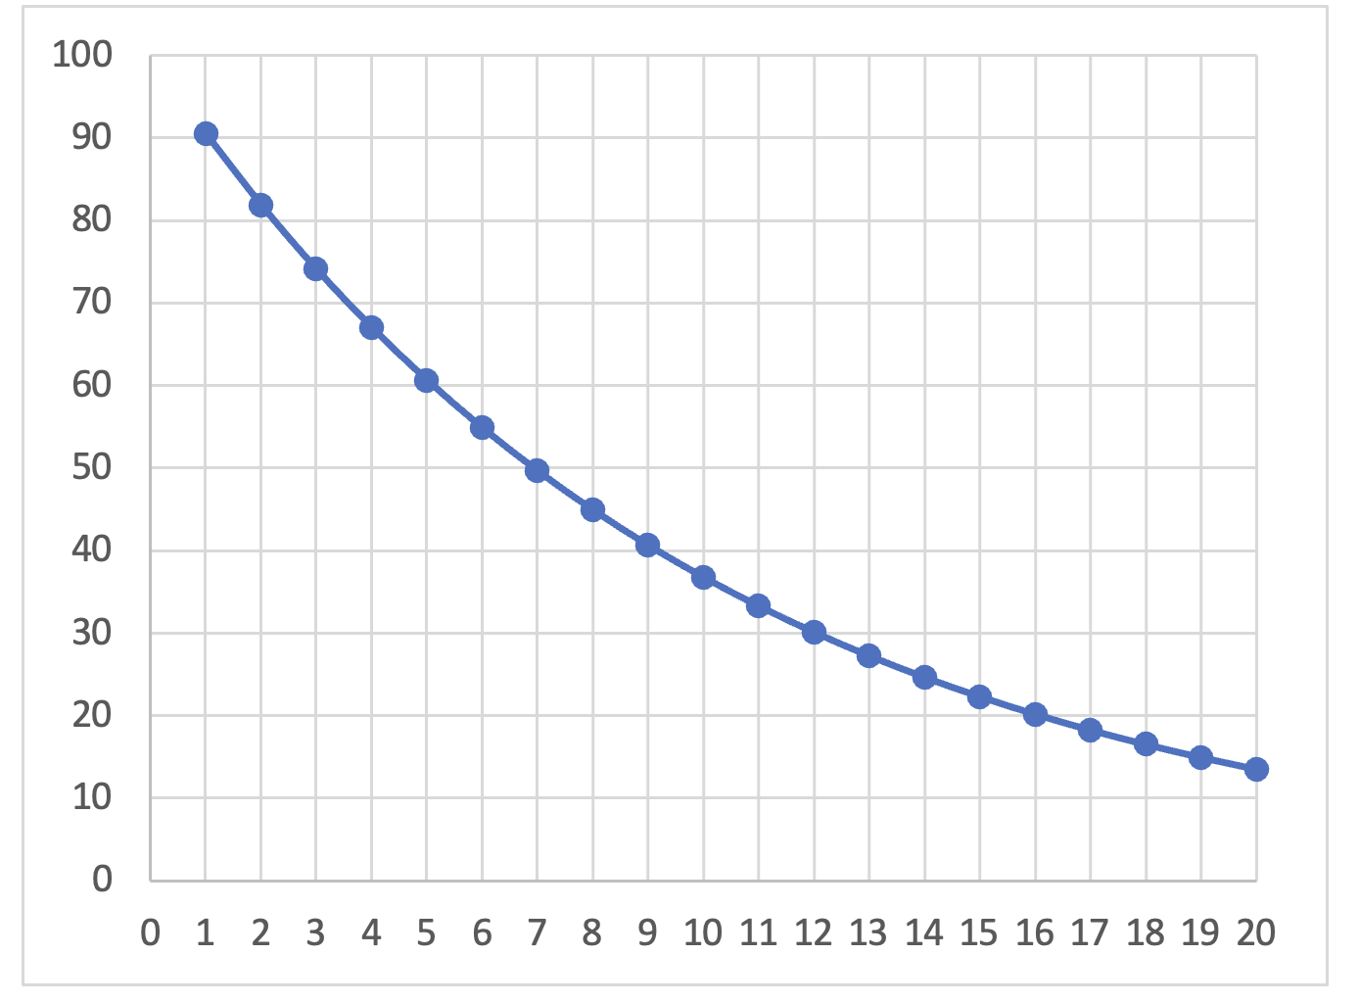
Notes:
It is exponential if the gap for any percentage drop is always the same. We can check this, and we do check it here using animations. However, we can also straighten the graph.
We often use the time taken to get to half but there is nothing particularly special about half (except it’s easy to check). In this example it always takes around 7 to drop by half.

Slide 23
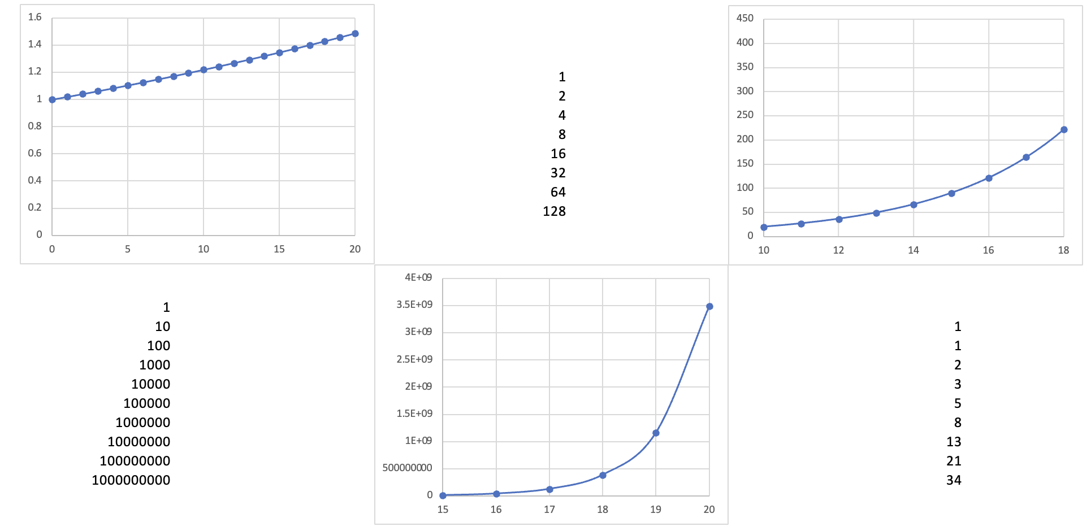
Which graphs show exponential growth?
D
A
B
C
E
F

Slide 24
Which graphs show exponential growth?
D
A
B
C
E
F
Notes:
The bottom-right is a Fibonacci sequence

Slide 25
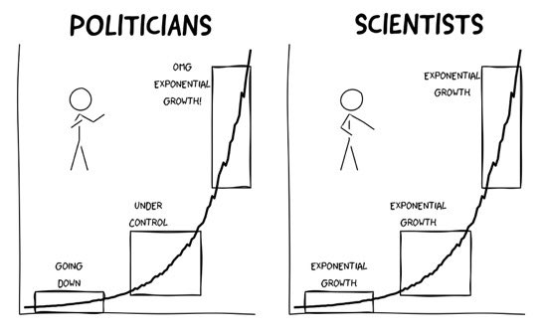
Jens von Bergmann
@vb_jens
Notes:
Exponential growth can be difficult to spot. This graph shows the different phases of exponential growth during the Covid pandemic.
Graph used with permission:
https://twitter.com/vb_jens/status/1372251931444350976
“There seems to be a renewed interest in this tweet and I again get question if people can use the graphic. The answer is Yes, and to clarify this I have uploaded the code with an open licence so people can also modify it to their taste.”

Slide 26
Radioactive Decay
Notes:
Use the following slides to write mentee questions and quiz them on it

Slide 27
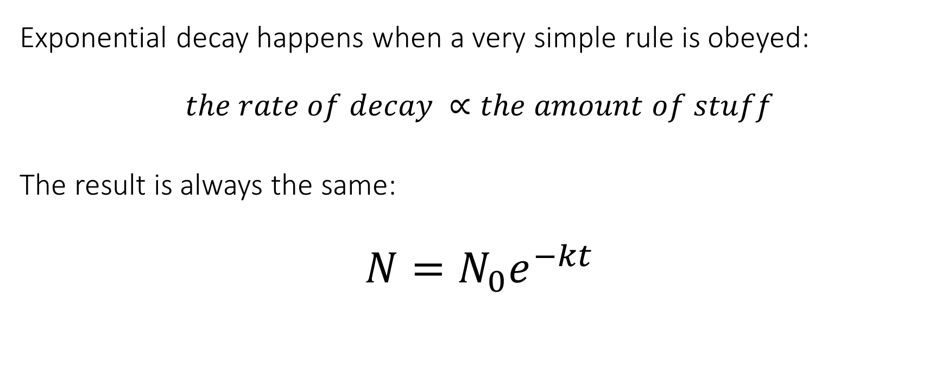

Exponential Decay Equation
Exponential decay happens when a very simple rule is obeyed:
$$the rate of decay ∝the amount of stuff$$
The result is always the same:
$$N=N_{0}e^{−kt}$$
$$N = stuff at time t$$
(radioactive particles, charge, current, etc.)
$$N_{0}=stuff at time t=0$$
$$k=some constant$$
$$t=time$$
Notes:
This needs real emphasis. This is the starting point for all decay – and comprehending this means that students can have a physical understanding about exponential decay, rather than just treating it as an abstract mathematical problem.

Slide 28
Radioactive Dice!
What does a single die represent at the different points?
Why do we get more reliable graphs with 1,000 dice rolls compared to 100?
  Similarly, why do we get better graphs for N than A?
Predict the shape the graph would be if they were 20-sided dice.
Predict the shape of the graph if they were 6-sided dice, but a 4, 5, or 6 counted as a decay.
  Why does this graph show exponential decay?
Notes:
Use the dice simulator spreadsheet and then ask the students to answer the questions. Students should be to use this understanding to see that increasing the decay constant will decrease the half-life, and because of the random nature of decays we are likely to get better results when we use larger numbers in our samples.

Slide 29
Exponential Beer Decay
Watch the radioactivity and beer video and answer the following questions (write these down):
Why do we not just measure the height of the bubbles?
Why do we wait for a couple of minutes at the end?
What could affect the speed at which the bubbles pop?
What assumptions are we making?
Notes:
Get the mentees to write these questions down before watching the video.

Slide 30
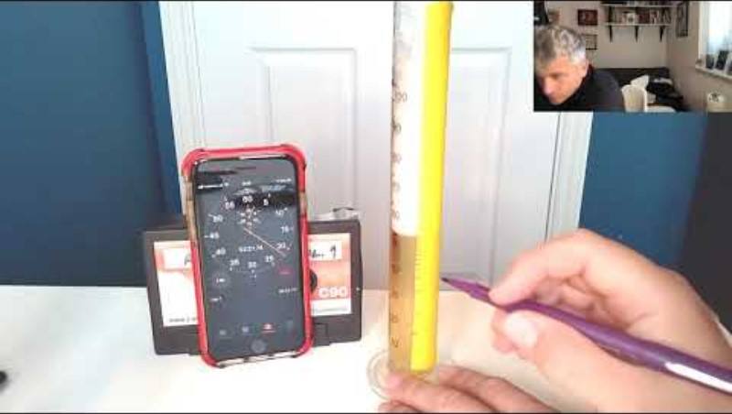
Notes:
If you have issues watching the video, you can just send the link through to the mentees and ask them to put and emoji in the chat after they have watched it: https://www.youtube.com/watch?v=rbhU8Fand2k

Slide 31
Exam Questions
Notes:
If you have time to do some!

Slide 32
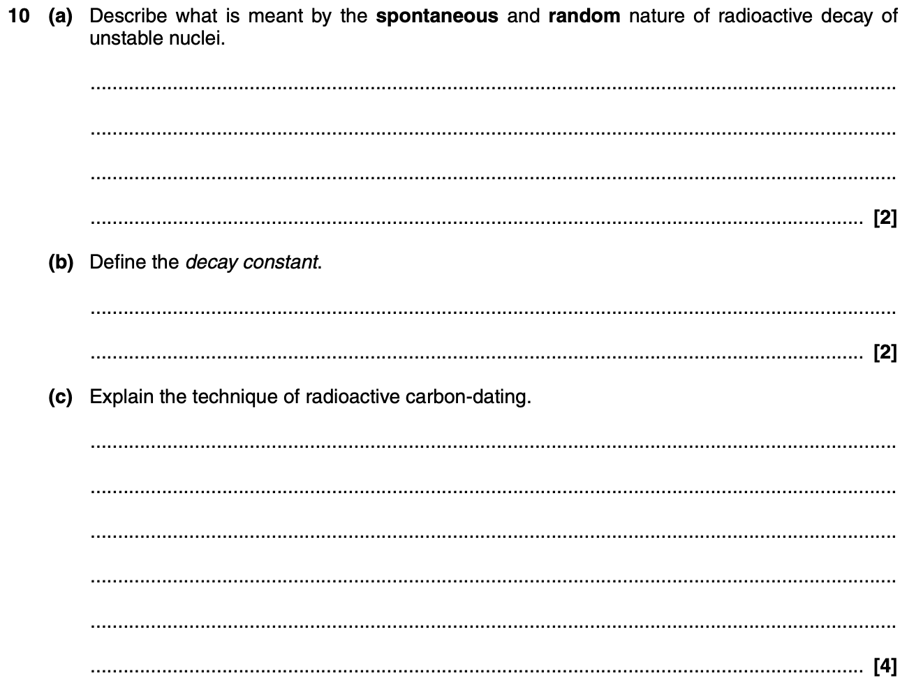
https://www.ocr.org.uk/Images/65365-question-paper-unit-g485-fields-particles-and-frontiers-of-physics.pdf
OCR
Wednesday 2 February 2001 - pm
A Level Physics A
G485, Fields, Particles and Frontiers of Physics
Notes:
Most of this question should be accessible to students even if they haven’t studied capacitors yet, with a bit of help. To solve the permittivity question in part (b) they may need to be told the equation for a capacitor.
Answers are here: https://www.ocr.org.uk/Images/58216-mark-scheme-unit-g485-fields-particles-and-frontiers-of-physics-january.pdf
Depending on how much time you have left will affect the best way of running this. Ideally students will get a chance to solve the questions before you give the answers.
You can do this in a number of ways to suit your group:
leave it in PowerPoint and annotate over the top using a tablet
use the Whiteboard function on Zoom so that everyone can add their own answers before you go through it
print out the worksheets and use a visualiser to work through the answers.

Slide 33
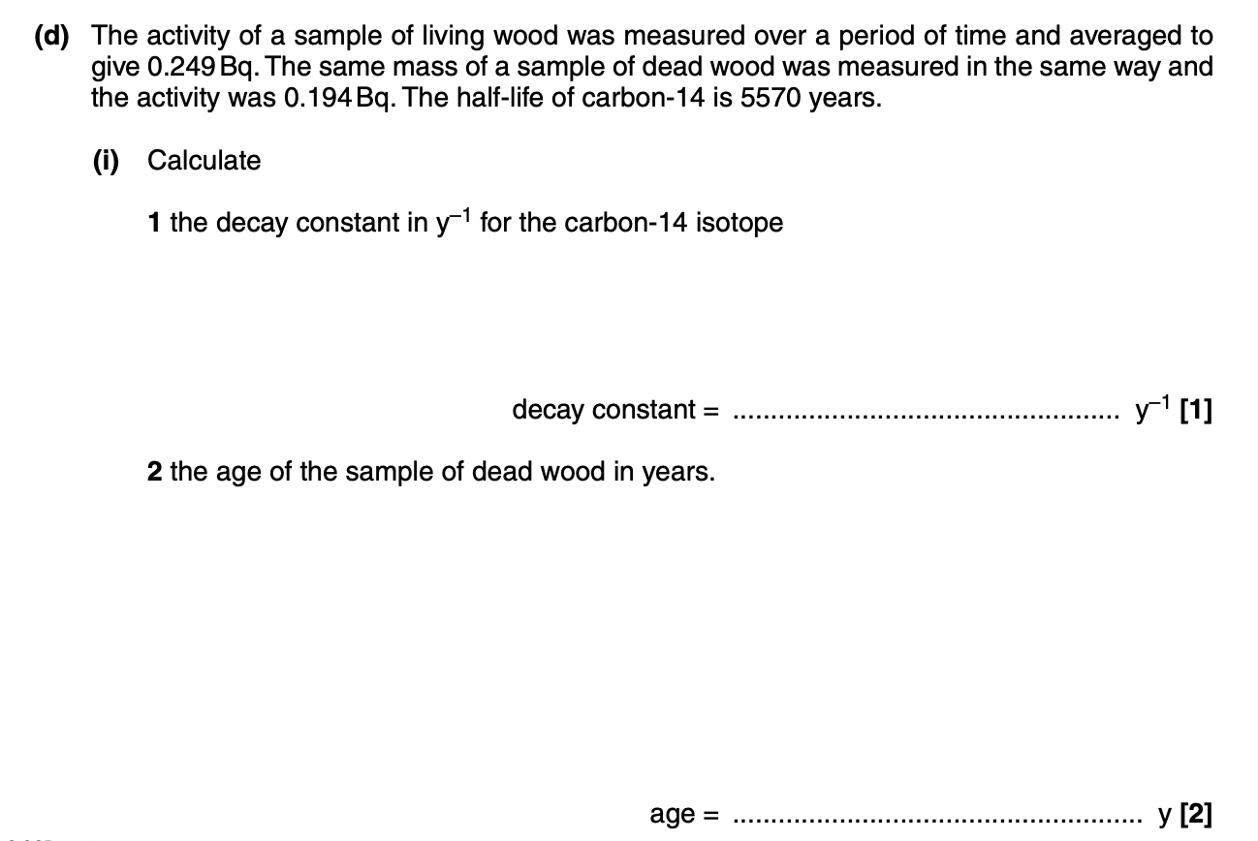
Notes:
Most of this question should be accessible to students even if they haven’t studied capacitors yet, with a bit of help. To solve the permittivity question in part (b) they may need to be told the equation for a capacitor.
Answers are here: https://www.ocr.org.uk/Images/58216-mark-scheme-unit-g485-fields-particles-and-frontiers-of-physics-january.pdf
Depending on how much time you have left will affect the best way of running this. Ideally students will get a chance to solve the questions before you give the answers.
You can do this in a number of ways to suit your group:
leave it in PowerPoint and annotate over the top using a tablet
use the Whiteboard function on Zoom so that everyone can add their own answers before you go through it
print out the worksheets and use a visualiser to work through the answers.

Slide 34
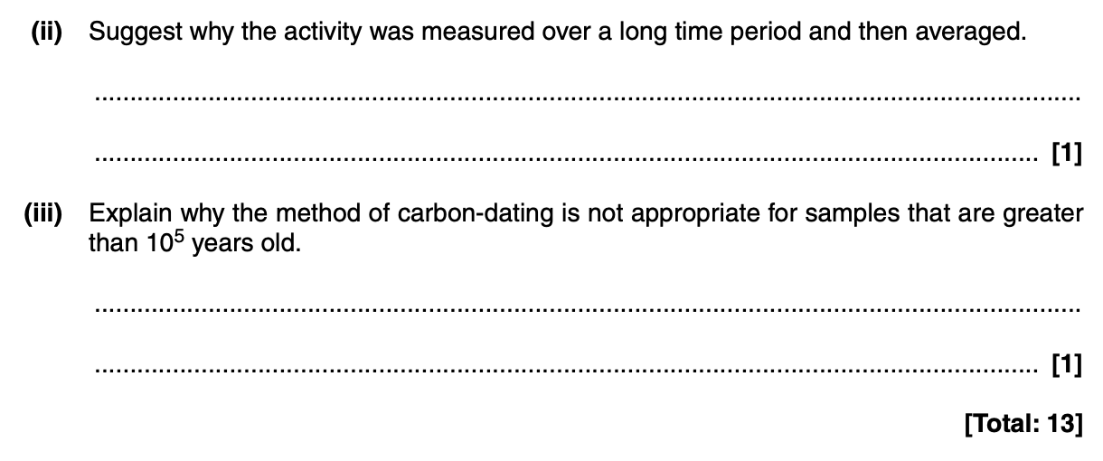
Notes:
Most of this question should be accessible to students even if they haven’t studied capacitors yet, with a bit of help. To solve the permittivity question in part (b) they may need to be told the equation for a capacitor.
Answers are here: https://www.ocr.org.uk/Images/58216-mark-scheme-unit-g485-fields-particles-and-frontiers-of-physics-january.pdf
Depending on how much time you have left will affect the best way of running this. Ideally students will get a chance to solve the questions before you give the answers.
You can do this in a number of ways to suit your group:
leave it in PowerPoint and annotate over the top using a tablet
use the Whiteboard function on Zoom so that everyone can add their own answers before you go through it
print out the worksheets and use a visualiser to work through the answers.

Slide 35
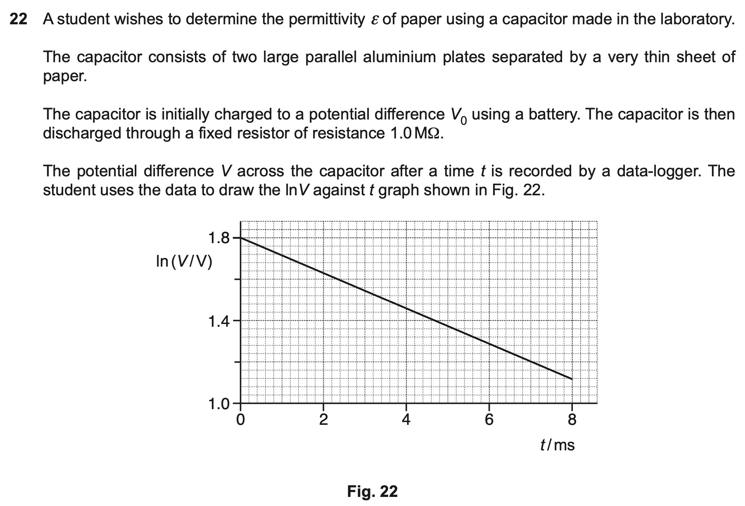
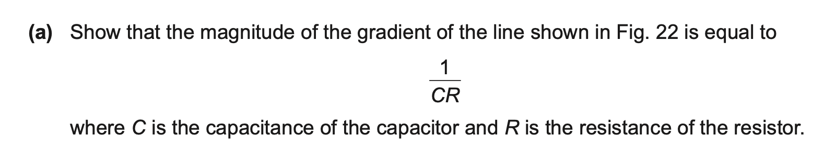
Notes:
Most of this question should be accessible to students even if they haven’t studied capacitors yet, with a bit of help. To solve the permittivity question in part (b) they may need to be told the equation for a capacitor.
Answers are here: https://www.ocr.org.uk/Images/58216-mark-scheme-unit-g485-fields-particles-and-frontiers-of-physics-january.pdf
Depending on how much time you have left will affect the best way of running this. Ideally students will get a chance to solve the questions before you give the answers.
You can do this in a number of ways to suit your group:
leave it in PowerPoint and annotate over the top using a tablet
use the Whiteboard function on Zoom so that everyone can add their own answers before you go through it
print out the worksheets and use a visualiser to work through the answers.

Slide 36

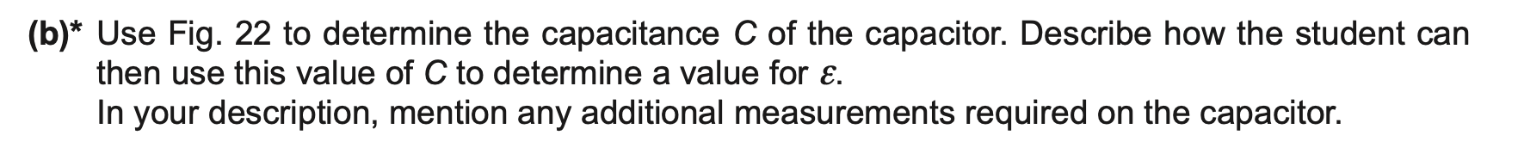
Notes:
Most of this question should be accessible to students even if they haven’t studied capacitors yet, with a bit of help. To solve the permittivity question in part (b) they may need to be told the equation for a capacitor.
Answers are here: https://www.ocr.org.uk/Images/58216-mark-scheme-unit-g485-fields-particles-and-frontiers-of-physics-january.pdf
Depending on how much time you have left will affect the best way of running this. Ideally students will get a chance to solve the questions before you give the answers.
You can do this in a number of ways to suit your group:
leave it in PowerPoint and annotate over the top using a tablet
use the Whiteboard function on Zoom so that everyone can add their own answers before you go through it
print out the worksheets and use a visualiser to work through the answers.

Slide 37

Questions?

