Slide 1
Physics Tutorial 4
Illustrating Like a Physicist

Slide 2



Introduction
Self-Study Recap
Why Graphs Are Useful
Kinetic Energy
Reflection

Slide 3
Introduction

Slide 4
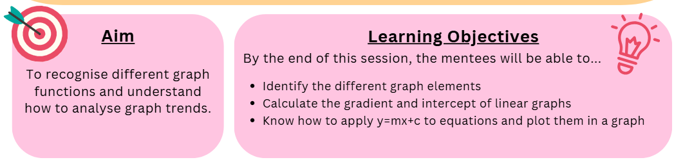
Aims and Learning Objectives

Slide 5
Ground Rules Reminder
You will need to attempt the home learning before the tutorial for the course to be effective.
Try to find a quiet space where you will not be interrupted, and spend at least 30 minutes on these problems. They could take up to an hour.
We do not expect you to always be able to answer every question in the home-learning, or during the tutorial. Being a good physicist is not about being able to answer everything straight away! We do want you to think about why you are getting stuck, and which questions you need to ask to help you develop your physics skills.
We would like you to attempt every question and record all your working and assumptions, even if you do not get a final answer.
Please arrive on time to the tutorials (aim to be a couple of minutes early if possible) and have the following materials with you:
  answers electronically or written down
  pen and paper
  a scientific calculator
Notes:
If needed

Slide 6
Self-Study Recap

Slide 7
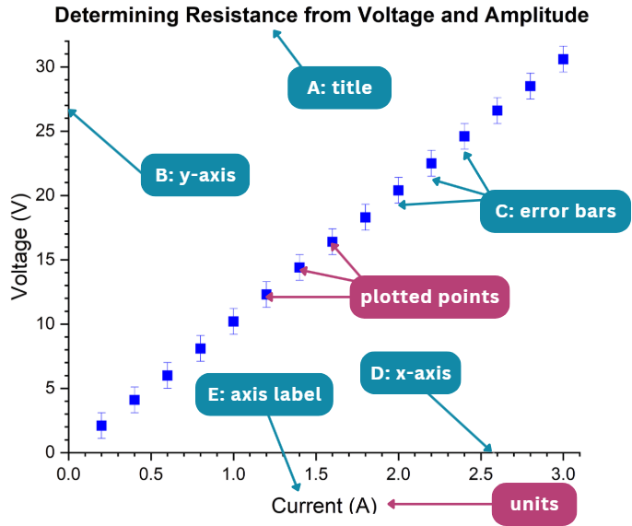
Task 1: The Basics

Slide 8
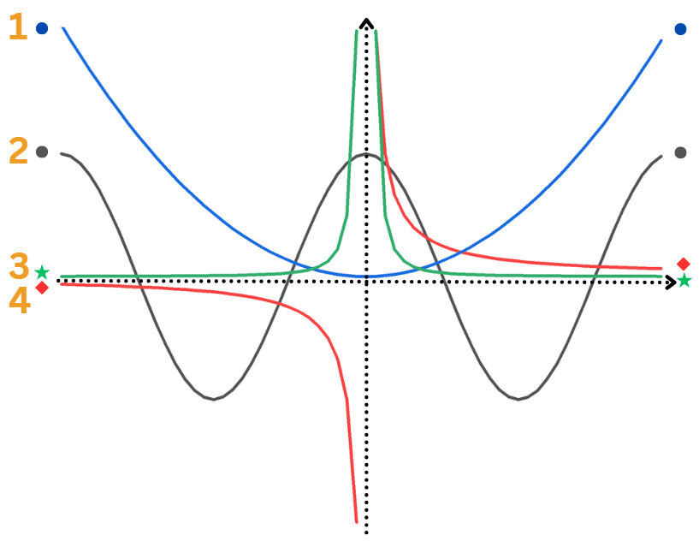
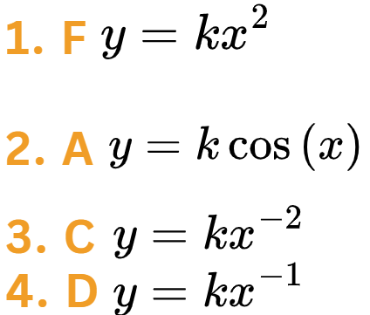
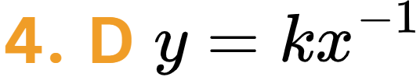
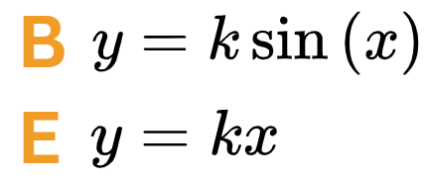
Task 2: Recognising Graphs
What do you think the other graphs would look like??

Slide 9
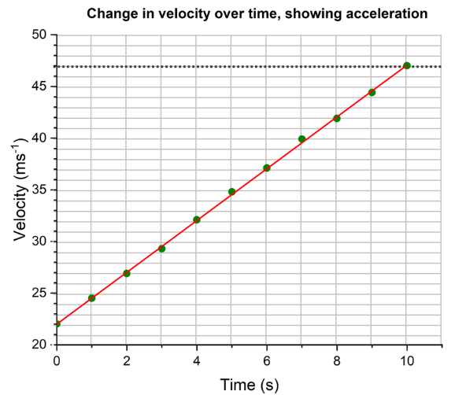
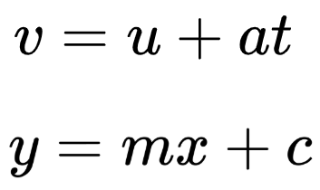


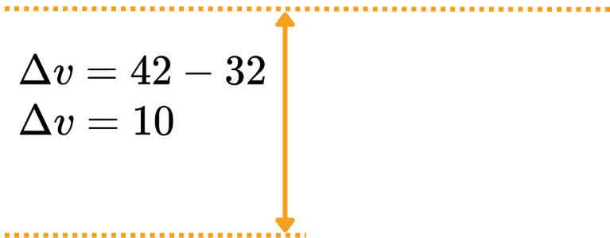
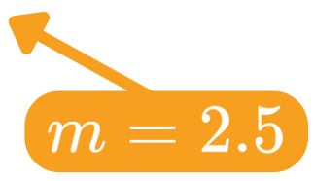
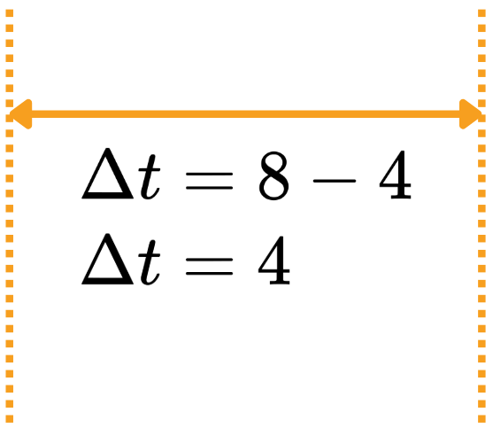
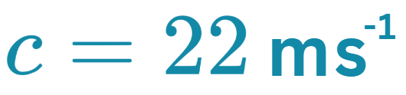
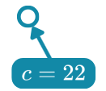

Task 3: Finding the Constants
Can you see the similarities between the equations?
So let’s find the y-intercept first…
And now the gradient…

Slide 10
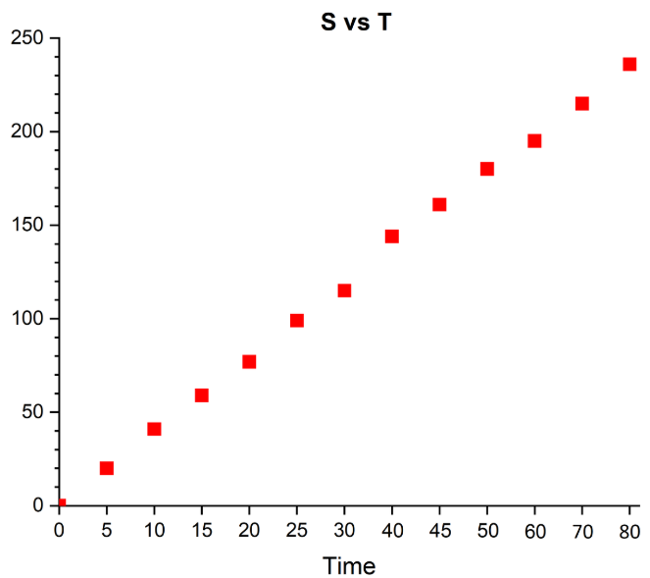

Task 4: Plotting Graphs
TITLE: we don’t know what ‘S’ and ‘T’ represent
AXIS LABELS:
  X-AXIS: no units for time
  Y-AXIS: no axis label at all
AXES: the data intervals on the x-axis aren’t evenly spaced
ERROR BARS: there are none!
GRIDLINES: none of these either

Slide 11

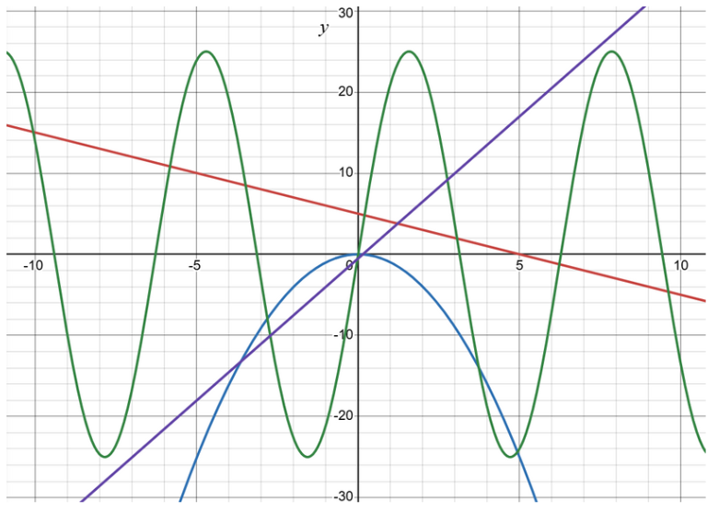

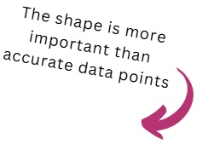


Task 4: Plotting Graphs

Slide 12

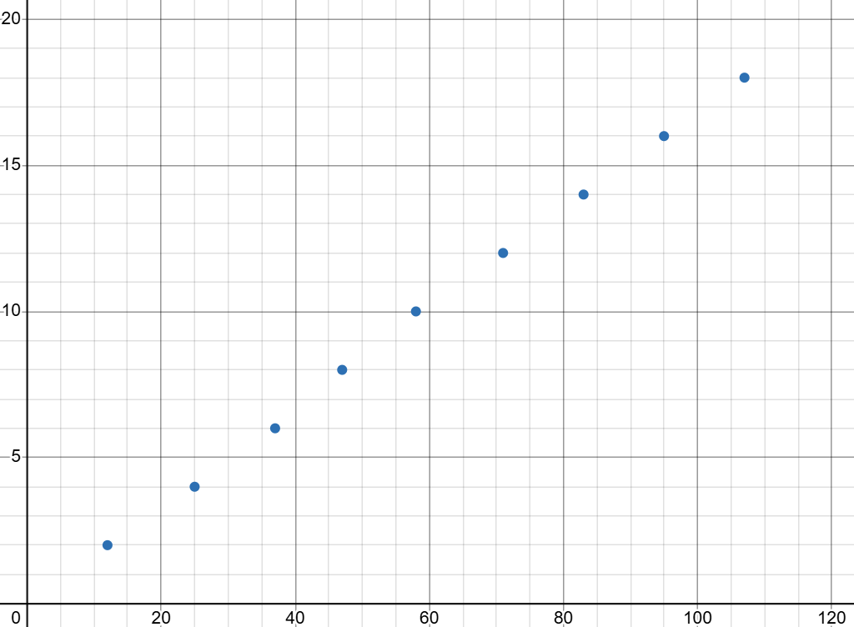

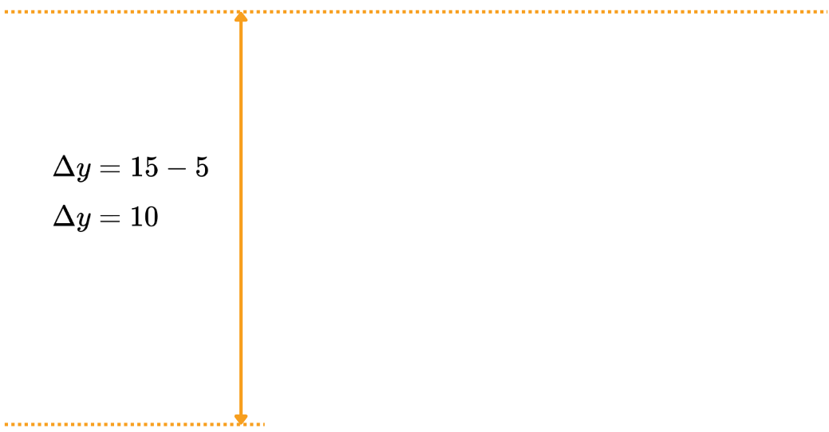


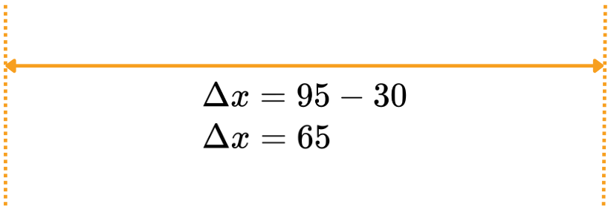
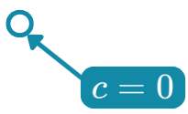

Task 4: Plotting Graphs
Now let’s find the y-intercept…
Then the gradient…

Slide 13

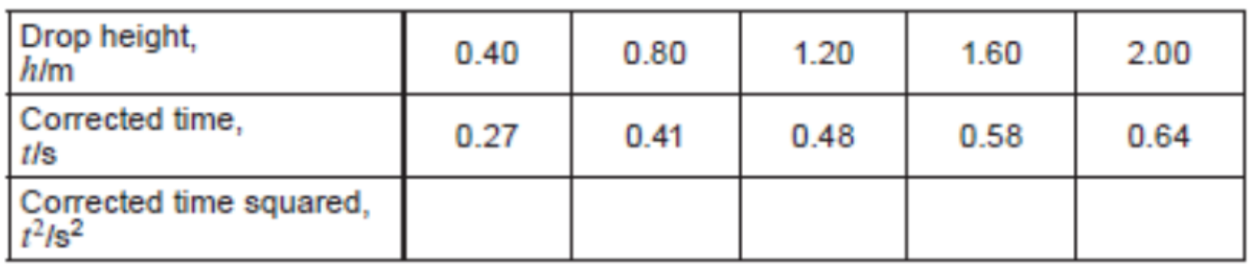
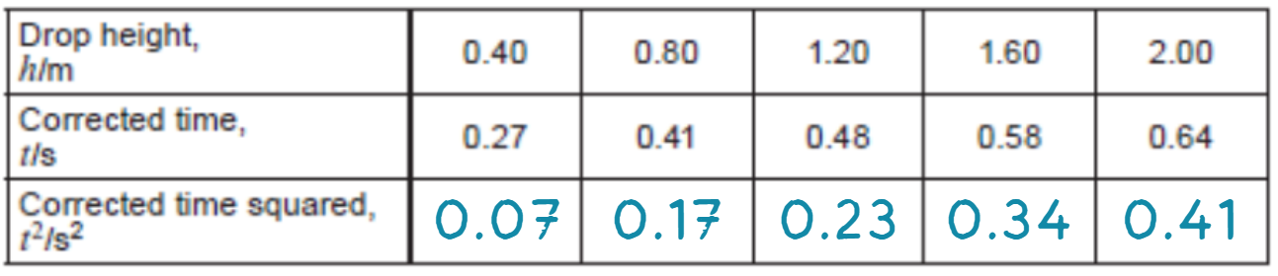

Exam Practice

Slide 14
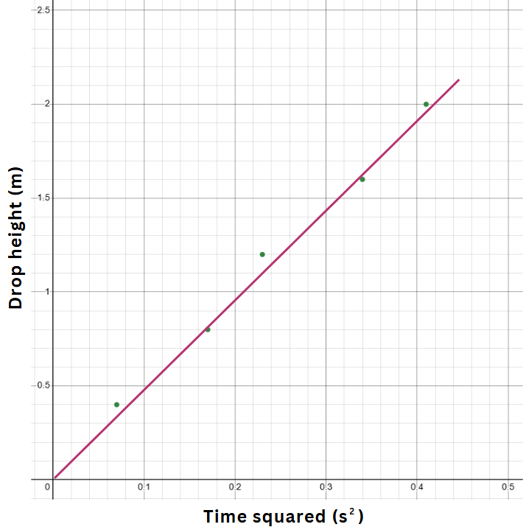

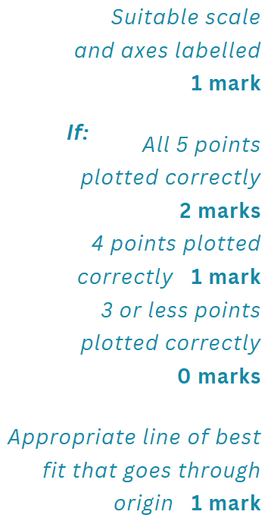



Exam Practice

Slide 15

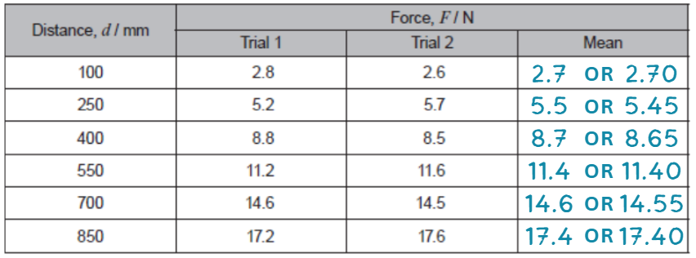
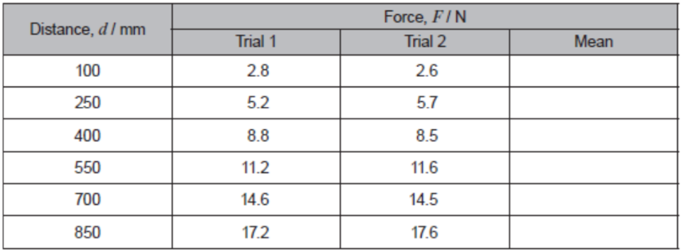
Exam Practice

Slide 16

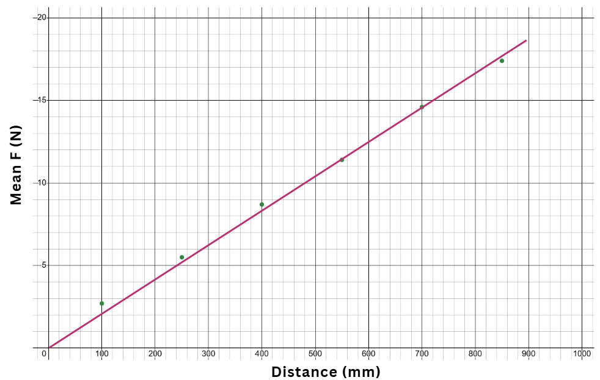
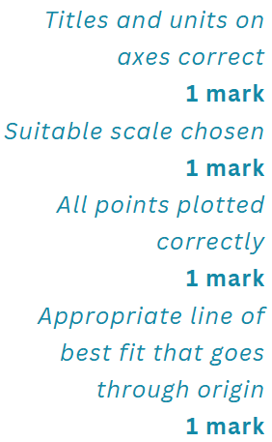
Exam Practice

Slide 17
Why Graphs Are Useful

Slide 18
Gradient and Intercept
What are the definitions of gradient and intercept?
Why are they important in science?

Slide 19
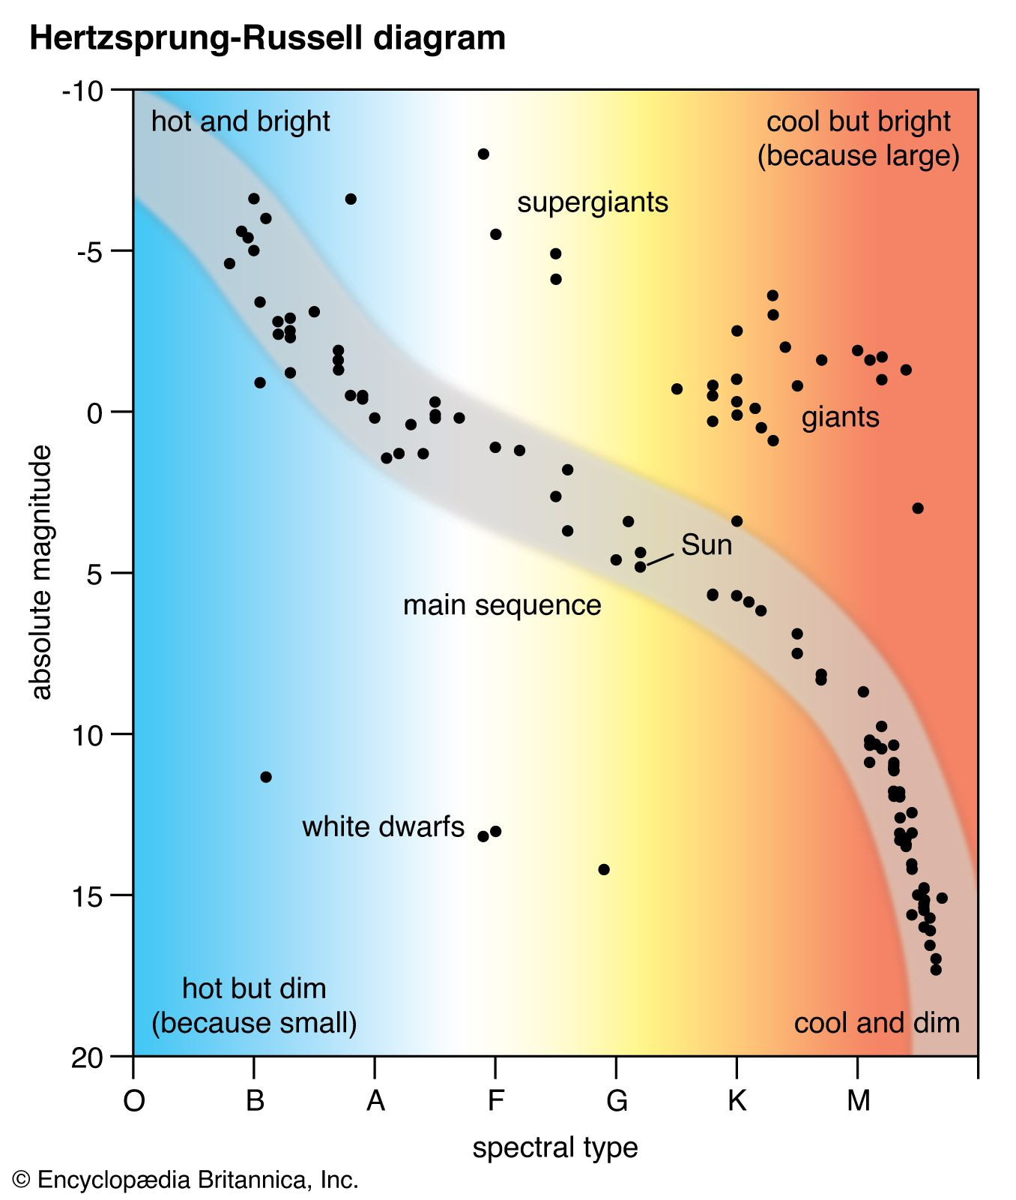

Slide 20
Kinetic Energy
Notes:
Use the following slides to write mentee questions and quiz them on it

Slide 21
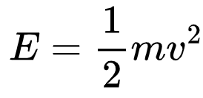
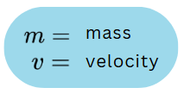
Kinetic Energy
What is kinetic energy?
Can you remember the equation?

Slide 22
Graph Drawing
Draw a graph of energy versus velocity squared using this data:
Kinetic Energy (J) | 0.17 | 0.34 | 0.51 | 0.67 | 0.80 | 0.89
Velocity (m/s) | 1.8 | 2.5 | 3.3 | 3.7 | 4.0 | 4.2

Slide 23
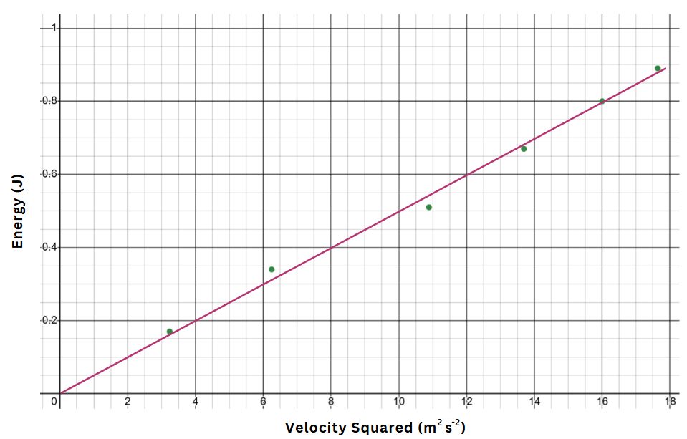

Slide 24
Graph Drawing
How would you calculate the mass using your graph??

Slide 25

Questions?

