Slide 1
Physics Tutorial 7
We’re All Physicists!

Slide 2



Introduction
Self-Study Recap
Wind Farm Presentations
Discussion Time
Optional Extras (if time)
Questions

Slide 3
Introduction

Slide 4
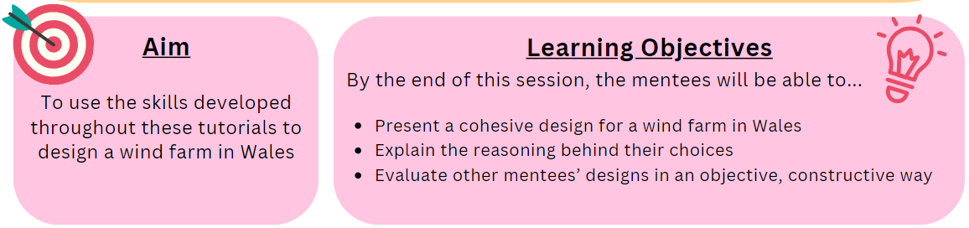
Aims and Learning Objectives

Slide 5
Ground Rules Reminder
You will need to attempt the home learning before the tutorial for the course to be effective.
Try to find a quiet space where you will not be interrupted, and spend at least 30 minutes on these problems. They could take up to an hour.
We do not expect you to always be able to answer every question in the home-learning, or during the tutorial. Being a good physicist is not about being able to answer everything straight away! We do want you to think about why you are getting stuck, and which questions you need to ask to help you develop your physics skills.
We would like you to attempt every question and record all your working and assumptions, even if you do not get a final answer.
Please arrive on time to the tutorials (aim to be a couple of minutes early if possible) and have the following materials with you:
  answers electronically or written down
  pen and paper
  a scientific calculator
Notes:
If needed

Slide 6
Self-Study Recap

Slide 7
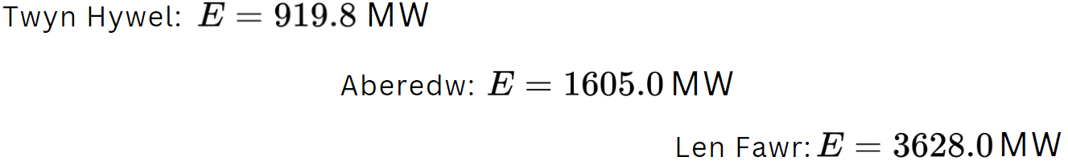
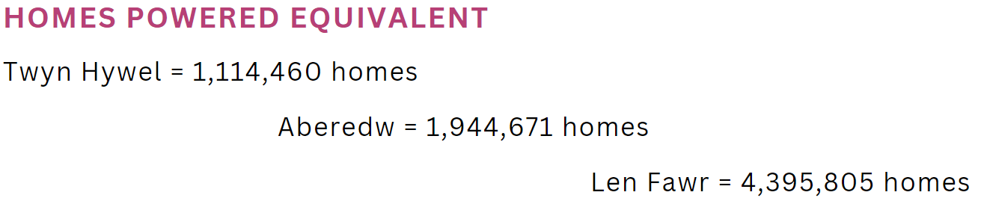
Task 1: Wind Turbine Energy Yield
Use the worked example methods to calculate the values:

Slide 8
Task 1: Wind Turbine Energy Yield
On the websites for each wind farm (each button has the link), the MW produced and homes powered equivalent is lower than the values we’ve just calculated. Why?
Not all the power generated will reach the generator, due to losses when converting from mechanical to electrical power
These calculations are in a perfect world - in reality, there will be inefficiencies in the designs of the turbines, loss of power due to friction in the blade motors, etc. which causes the actual power generated to be lower.

Slide 9
Wind Farm Presentations!

Slide 10
Wind Farm Presentations
You will have 5 minutes to present your wind farm
If you’re watching, try to note down:
  2 things the presenter did well
  1 thing you think they could improve on
We will give some feedback at the end of each presentation
Notes:
Adjust timings as appropriate

Slide 11
Discussion Time

Slide 12
Discussion
Having seen the others’ ideas, is there anything you would change about your design?
Do you think your design would have come out differently if you worked in a group? Why/why not?
Can you think of a strength another student has? How could they use that as part of a team when making a design like this?
Notes:
Adjust timings as appropriate

Slide 13
Optional Extras

Slide 14

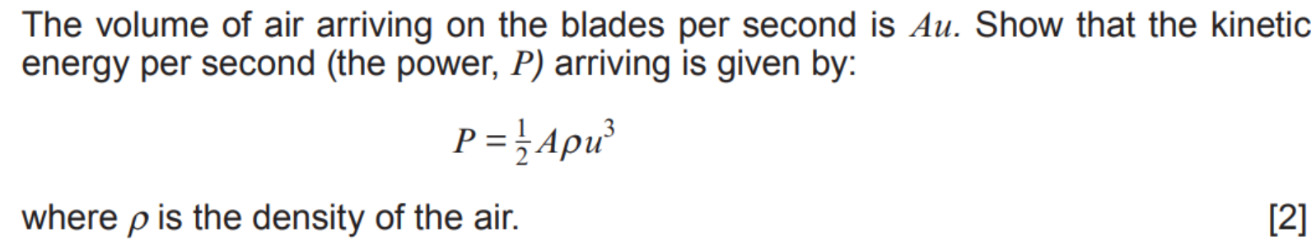
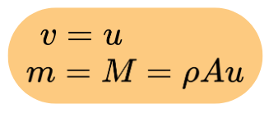
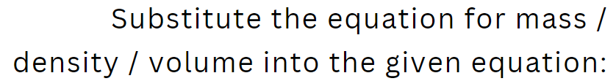
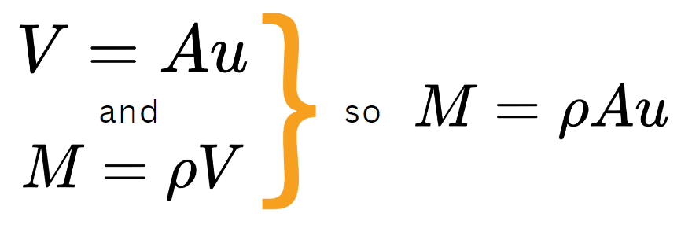
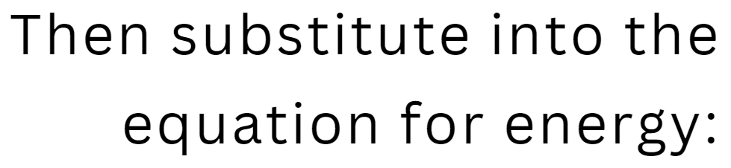

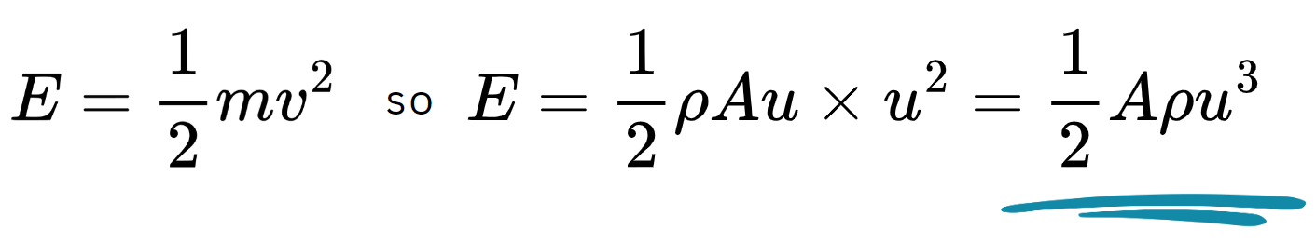
Exam Practice

Slide 15

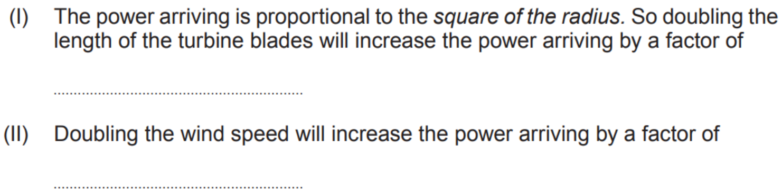



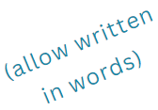
Exam Practice

Slide 16

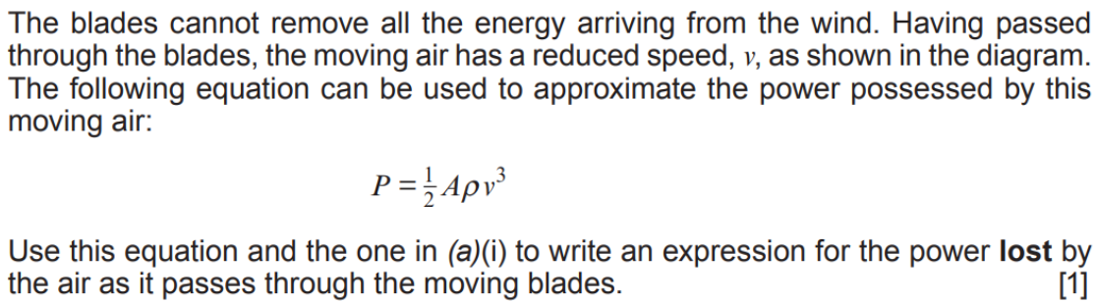

Exam Practice

Slide 17


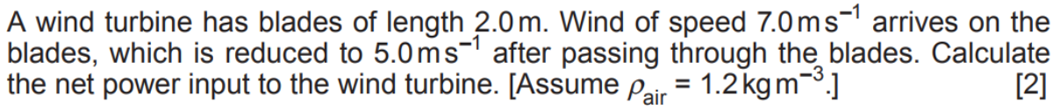



Exam Practice

Slide 18

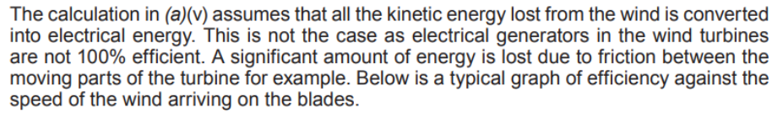
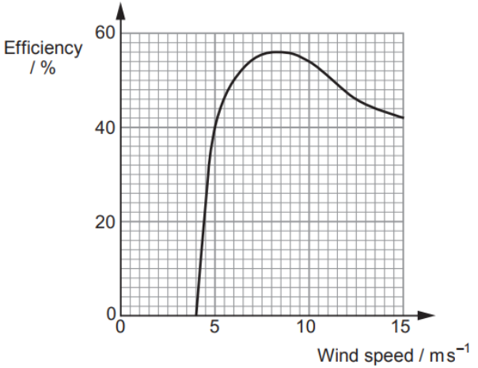


Exam Practice

Slide 19


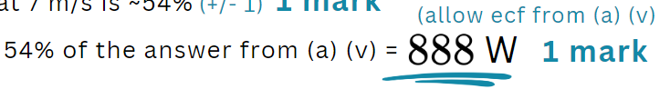
Exam Practice

Slide 20

Exam Practice

Slide 21

Questions?

