Slide 1
Physics Tutorial 6
Being a Physicist

Slide 2



Introduction
Self-Study Recap
Exam Practice
Revision Techniques
Questions

Slide 3
Introduction

Slide 4
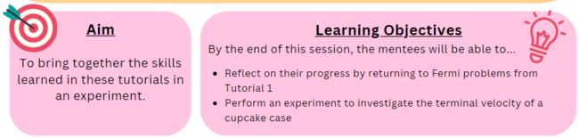
Aims and Learning Objectives

Slide 5
Ground Rules Reminder
You will need to attempt the home learning before the tutorial for the course to be effective.
Try to find a quiet space where you will not be interrupted, and spend at least 30 minutes on these problems. They could take up to an hour.
We do not expect you to always be able to answer every question in the home-learning, or during the tutorial. Being a good physicist is not about being able to answer everything straight away! We do want you to think about why you are getting stuck, and which questions you need to ask to help you develop your physics skills.
We would like you to attempt every question and record all your working and assumptions, even if you do not get a final answer.
Please arrive on time to the tutorials (aim to be a couple of minutes early if possible) and have the following materials with you:
answers electronically or written down
pen and paper
a scientific calculator
Notes:
If needed

Slide 6
Self-Study Recap

Slide 7
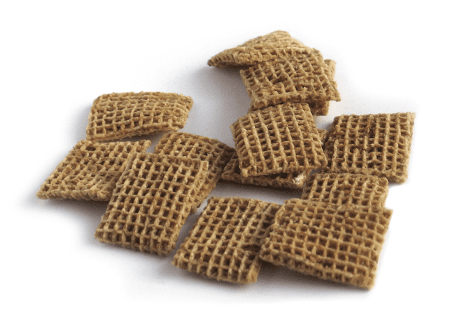


Task 1: Fermi Problems
1. How many Shreddies has the average 17-year-old eaten?
2. How many pound coins can you fit in an average backpack?

Slide 8
Task 2: Experiment!
What were the biggest challenges of this experiment?
How could it be improved?
What was similar/different between everyone’s experiments and results?
Is there anything you’d do differently after seeing the others’ experiments?

Slide 9


Optional Extras: Fermi Problems
1. How many blades of grass are there on a football pitch?
2. How many times do you blink in a year?

Slide 10
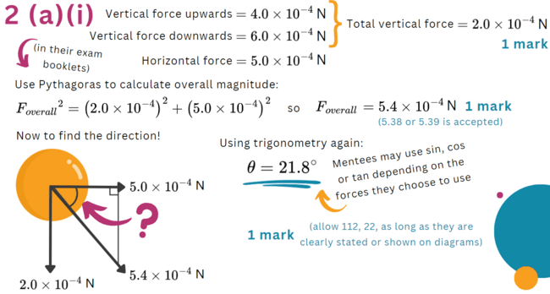
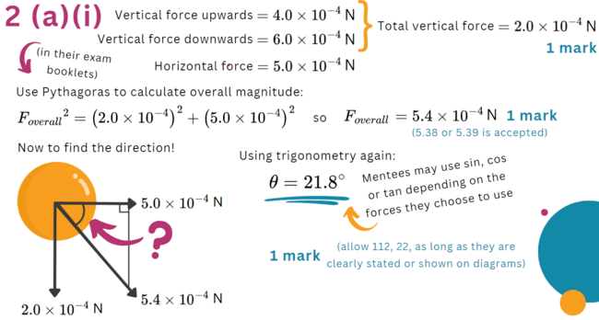
Optional Extras: Exam Practice

Slide 11
Optional Extras: Exam Practice

Slide 12

Optional Extras: Exam Practice

Slide 13
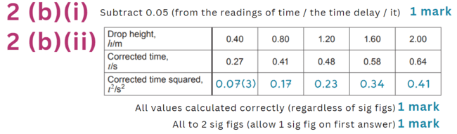
Optional Extras: Exam Practice

Slide 14
Exam Practice Continued

Slide 15

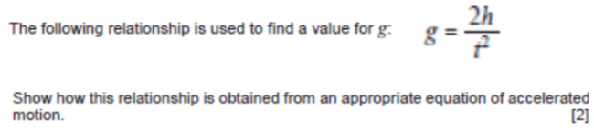
Exam Practice Continued

Slide 16

Exam Practice Continued

Slide 17
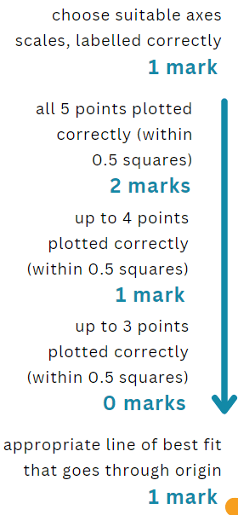
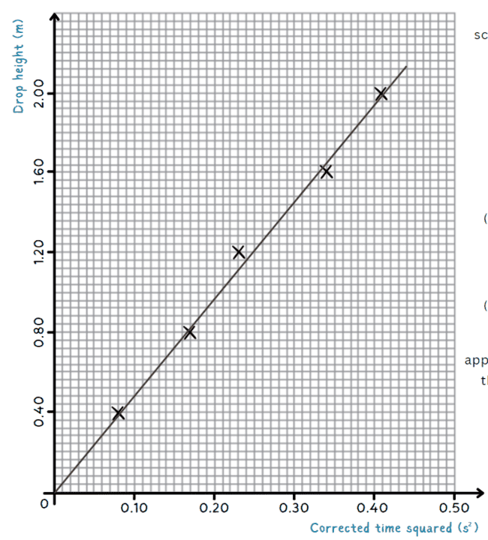

Slide 18
Exam Practice Continued

Slide 19
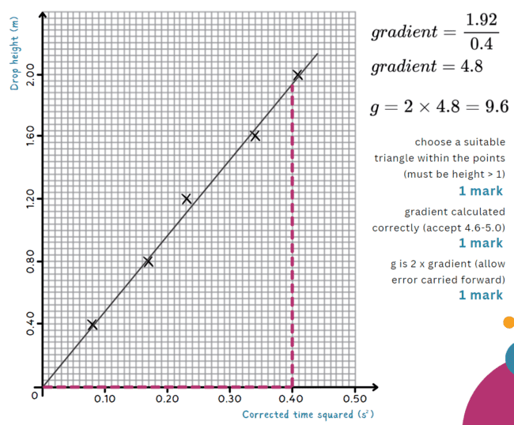

Slide 20
Revision Techniques

Slide 21
Revision
What revision strategies do you use?
How do you plan your revision time?

Slide 22
Past Paper Top Tips
Do them regularly but with space in between – not all in one day
Make sure to mark them using the mark scheme
The questions you can’t answer are much more important than the ones you can easily do - these are the ones you need to practice more often
Be tough when marking yourself - “I know what I meant” won’t get you a mark in the exam if it’s not on the mark scheme!

Slide 23

Questions?

