Slide 1
Cycle 1: Tutorial
Month Year
Mentor Name 1 Mentor Name 2

Slide 2
Self-study Review

Slide 3
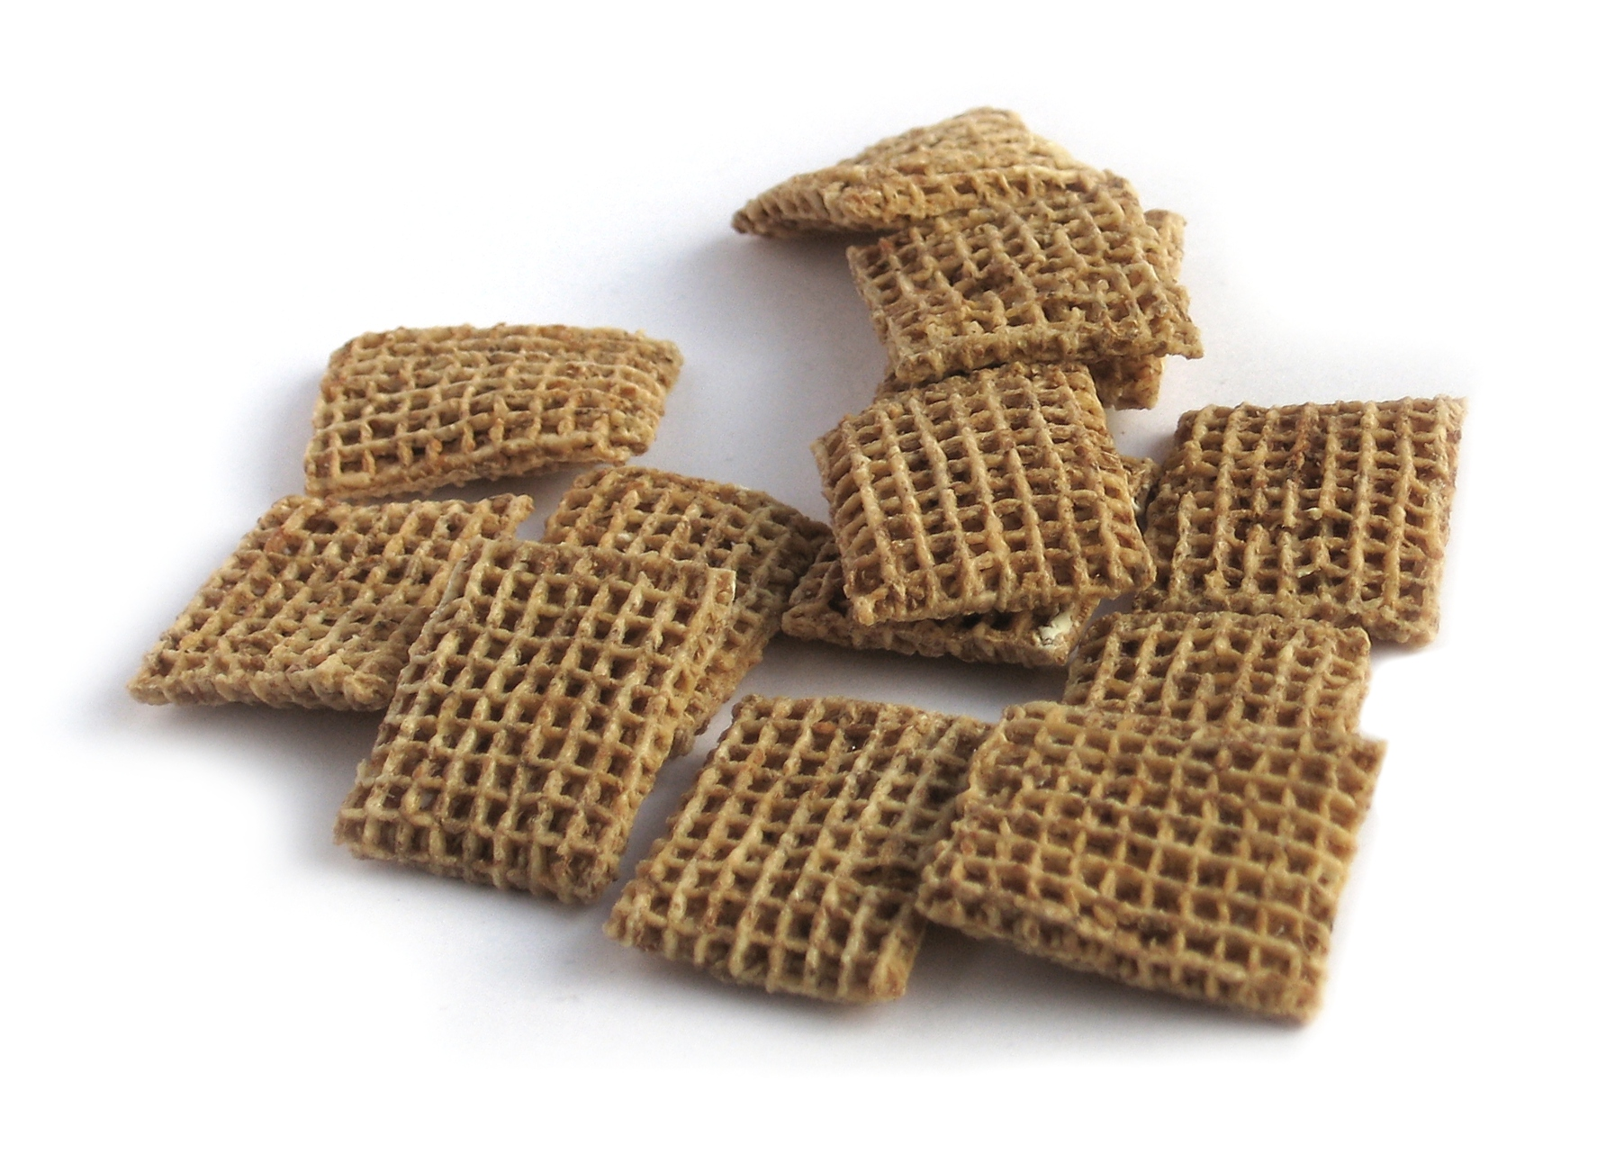
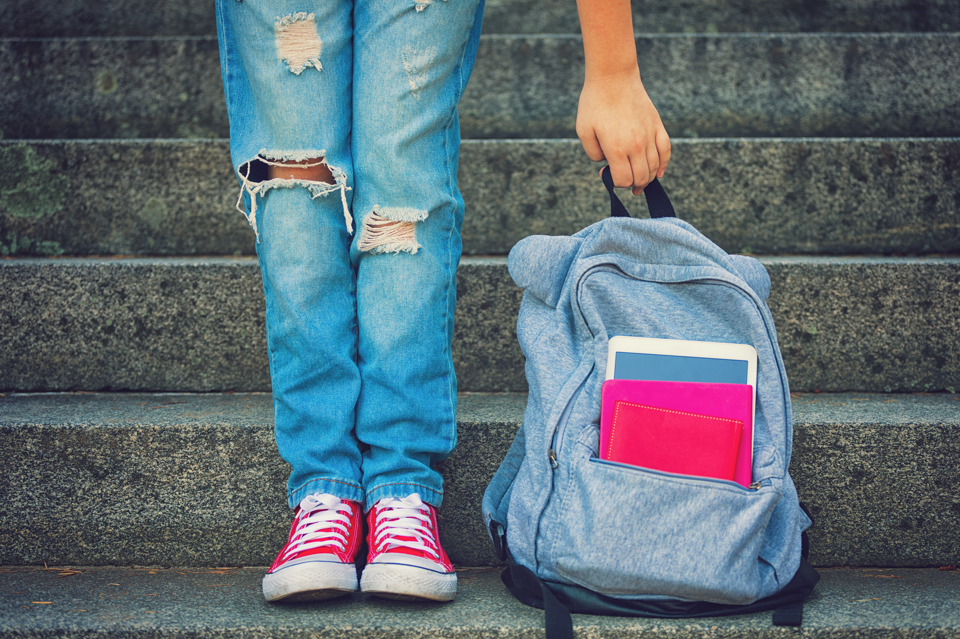
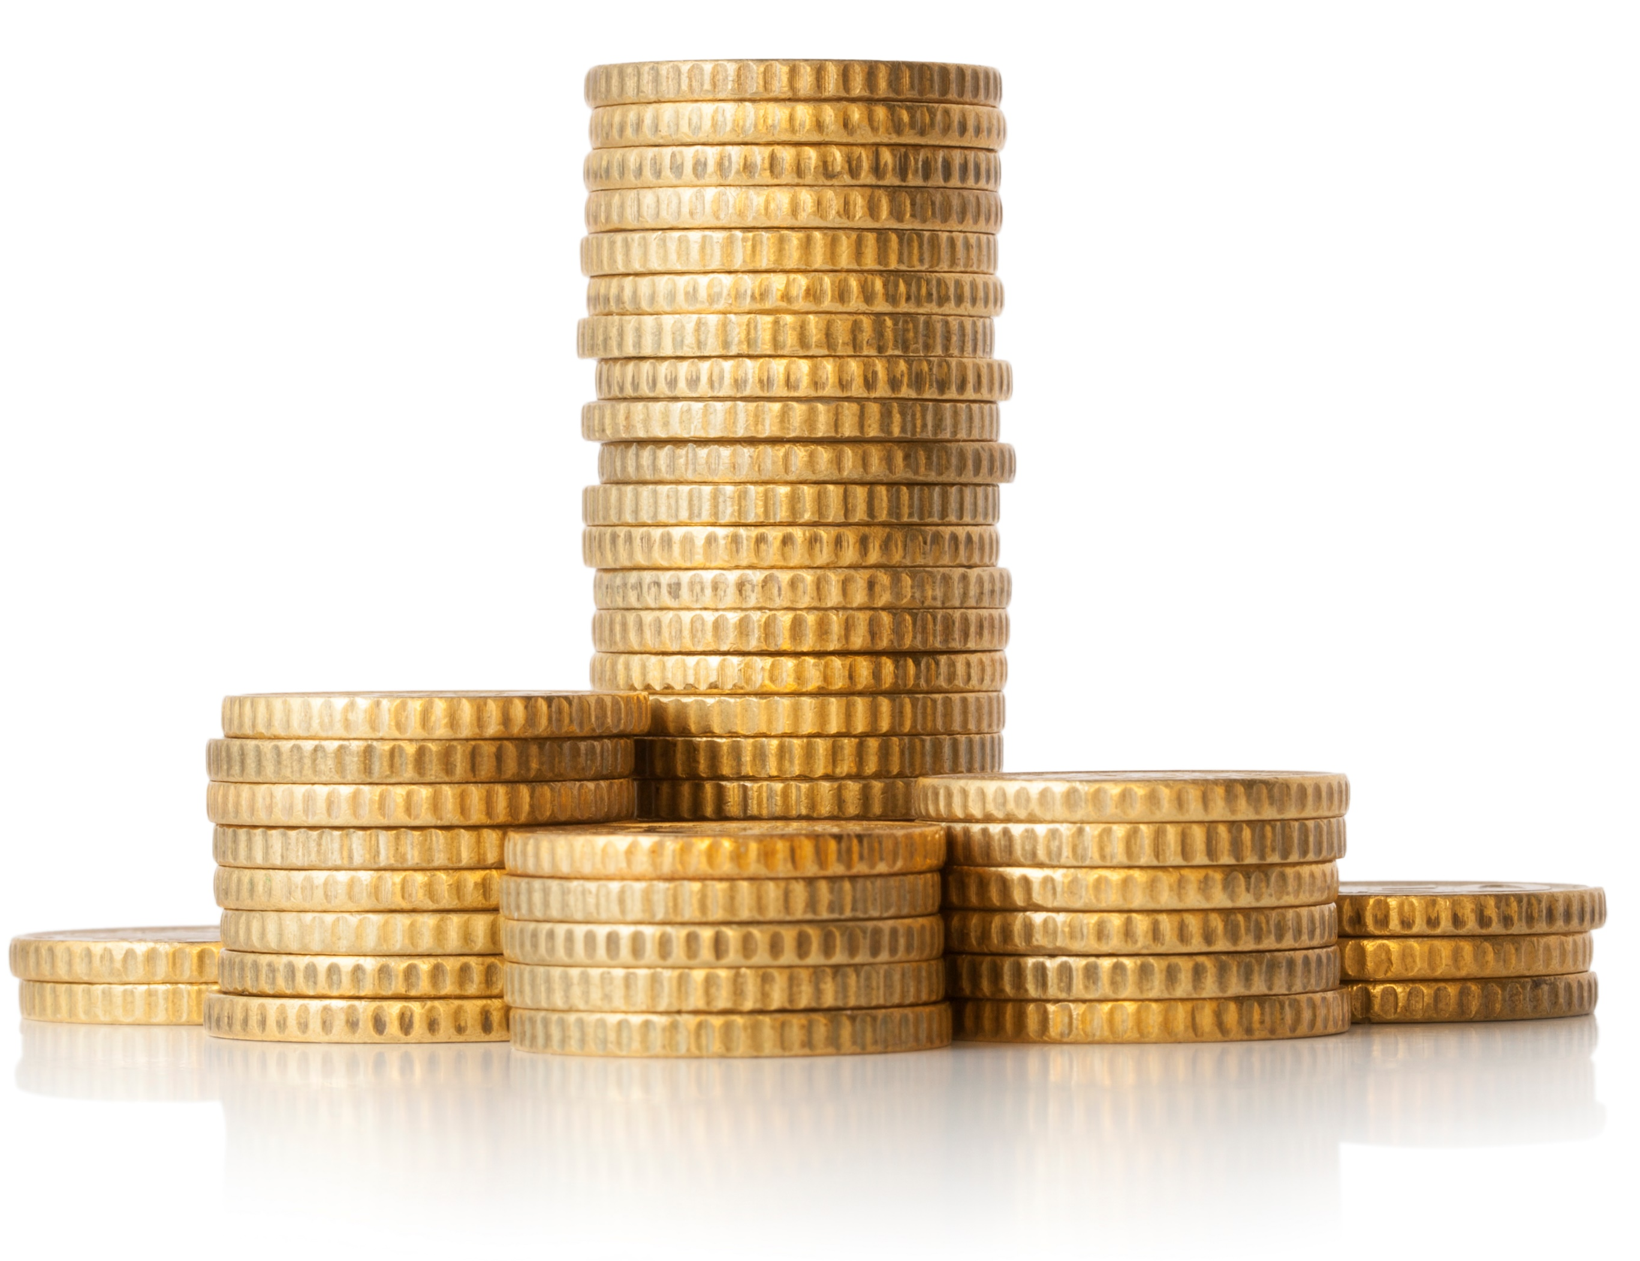
Fermi Problems
1. How many Shreddies has the average 17-year-old eaten?
2. How many pound coins can you fit in an average backpack?

Slide 4
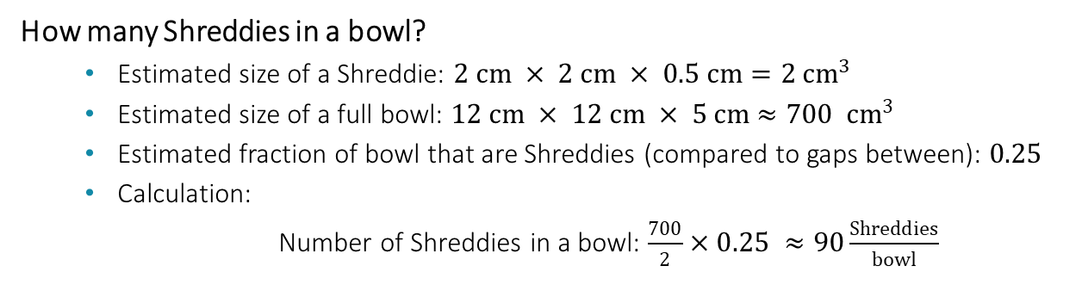
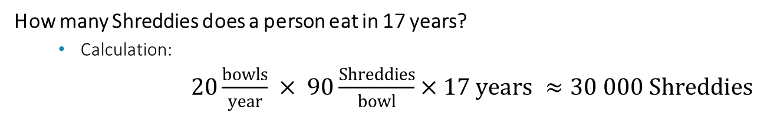
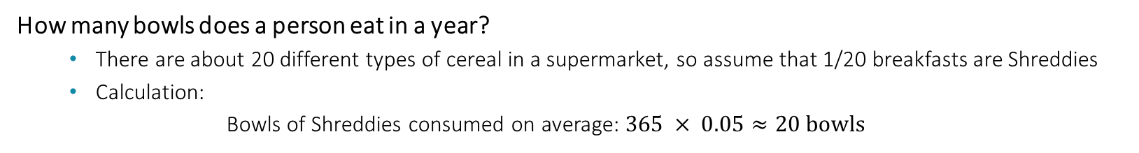
1. How many Shreddies has the average 17-year-old eaten?
How many Shreddies in a bowl?
  Estimated size of a Shreddie: $2 cm × 2 cm × 0.5 cm=2 cm^{3}$
  Estimated size of a full bowl: $12 cm × 12 cm × 5 cm$ $≈700 cm^{3}$
  Estimated fraction of bowl that are Shreddies (compared to gaps between): $0.25$
  Calculation:
  Number of Shreddies in a bowl: $\frac{700}{2}×0.25 ≈90\frac{Shreddies}{bowl}$
How many bowls does a person eat in a year?
  There are about 20 different types of cereal in a supermarket, so assume that 1/20 breakfasts are Shreddies
  Calculation:
  Bowls of Shreddies consumed on average: $365 × 0.05≈20 bowls$
How many Shreddies does a person eat in 17 years?
  Calculation:
  $20\frac{bowls}{year} × 90\frac{Shreddies}{bowl}×17 years ≈30 000 Shreddies$
Notes:
Use to insert media

Slide 5


1. Shreddies
What assumptions have you made?

Slide 6


1. Shreddies
What is your level of confidence in these estimations?

Slide 7
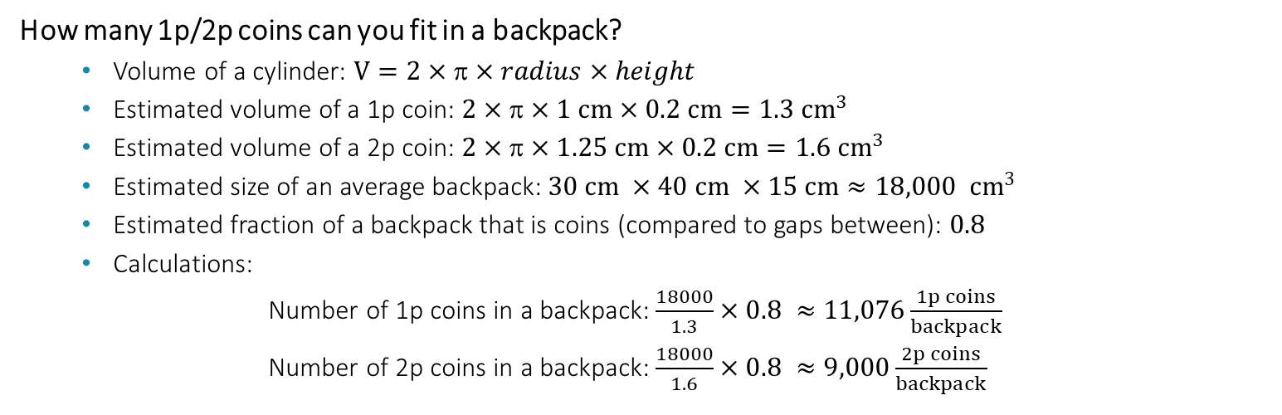
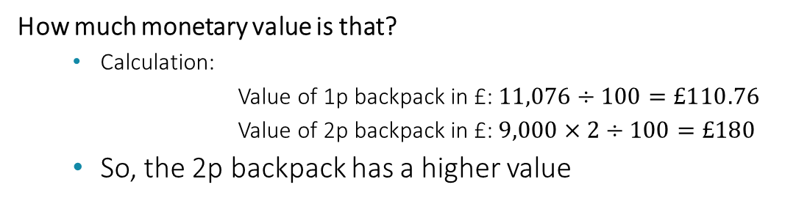
2. Could you fit more monetary value in a backpack in 1p or 2p coins?
How many 1p/2p coins can you fit in a backpack?
  Volume of a cylinder: $V=2××radius×height$
  Estimated volume of a 1p coin: $2××1 cm×0.2 cm=1.3 {cm}^{3}$
  Estimated volume of a 2p coin: $2××1.25 cm×0.2 cm=1.6 {cm}^{3}$
  Estimated size of an average backpack: $30 cm ×40 cm ×15 cm$ $≈18,000 cm^{3}$
  Estimated fraction of a backpack that is coins (compared to gaps between): $0.8$
  Calculations:
  Number of 1p coins in a backpack: $\frac{18000}{1.3}×0.8 ≈11,076\frac{1p coins}{backpack}$
  Number of 2p coins in a backpack: $\frac{18000}{1.6}×0.8 ≈9,000\frac{2p coins}{backpack}$
How much monetary value is that?
  Calculation:
  Value of 1p backpack in £: $11,076÷100=£110.76$
  Value of 2p backpack in £: $9,000×2÷100=£180$
  So, the 2p backpack has a higher value
Notes:
Use to insert media

Slide 8
2. Pennies
What assumptions have you made?

Slide 9
2. Pennies
What is your level of confidence in these estimations?

Slide 10




Physics Skills
What skills are you practising when you are solving Fermi questions that will help you as a scientist?

Slide 11
More Fermi Problems

Slide 12


Let’s try another Fermi problem…
How much energy is needed to heat up a bath?

Slide 13
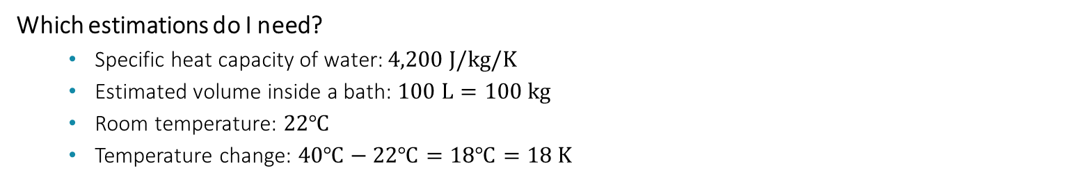
How much energy is needed to heat up a bath?
Which equations do I need?
  Energy equation: $energy=mass×specific heat capacity×temperature change$
Which estimations do I need?
  Specific heat capacity of water: $4,200 J/kg/K$
  Estimated volume inside a bath: $100 L=100 kg$
  Room temperature: $22℃$
  Temperature change: $40℃−22℃=18℃=18 K$
$$Energy ≈100 kg ×18 K × 4000 J/kg/K=8 000 000 J$$
Notes:
Use to insert media

Slide 14



Let’s try some more Fermi problems…
Suppose you were to print, in 12-point text, the number 1 using a common cheap ink-jet printer. How many molecules of the ink would be used? At what numerical value would the number printed approximately equal the number of ink molecules used?
Has humanity produced enough paint to cover the entire land area of the Earth?
If our Twitter timelines (tweets by the people we follow) actually extended off the screen in both directions, how tall would they be?

Slide 15

Questions?

